Slide 1


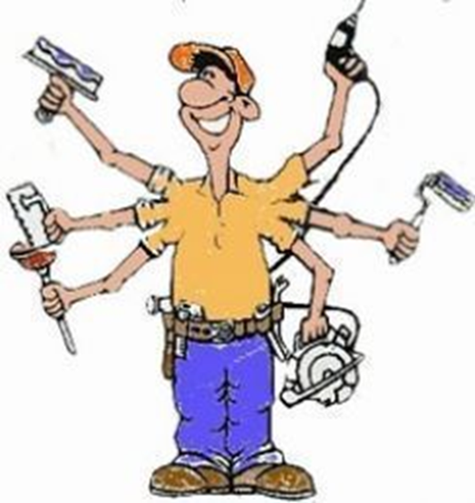
Kwa Thema Skills School
(School Of Specialization)
Maintenance Year 1 Learning Content

Slide 2
Overview of Maintenance
- Maintenance management is vital in ensuring the long term success of your maintenance program by monitoring quality assurance, maintaining operational efficiency and keeping assets in optimum running order.
- Properly maintained assets and resources keep your production stable and greatly minimize the chances for unplanned downtime.
At the end of the term learners should be able to:
1. Apply safety rules in the workshop.
2. Name or identify marking and cutting hand tools.
3. To know the uses of making and cutting hand tools.
4. Maintain hand and power tools or machines.
5. To know different types and sizes of sandpapers.
6. To different types of hinges.
7.To know different types of locks.
8. To make a Jewelry Box.

Slide 3
Maintenance Year 4
Content
1. Mechanical
1. Safety and Maintenance of :
1.1 Weed Eaters (Trimmers)
1.2 Blowers
1.3 Lawn Mowers (Pushers)
2. Identification of Serviceable Parts of a Car.
3. Minor Service of a Car.
2. Painting
1. Maintenance of Wood, Metals and Walls.
3.Glazing
1. Glazing Methods.
2. How do you remove old putty?
3. How do you apply window glazing using a putty?
4.Waterproofing
1. Purpose of Waterproofing.
2. Places where waterproofing is essential.
3. Waterproofing Methods.
5. Electrical
1. Soldering
2. How to wire a lamp

